Slide 1


Dichotomous key
Used to identify unknown organisms.
Made of many pairs of statements about features of organisms.
Each pair of statements describe the same feature but contrasting characteristics.
E.g. P15 on textbook.

Slide 2
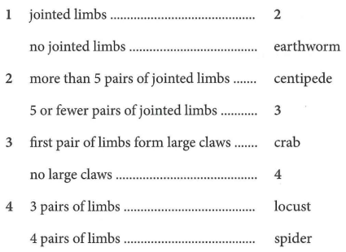
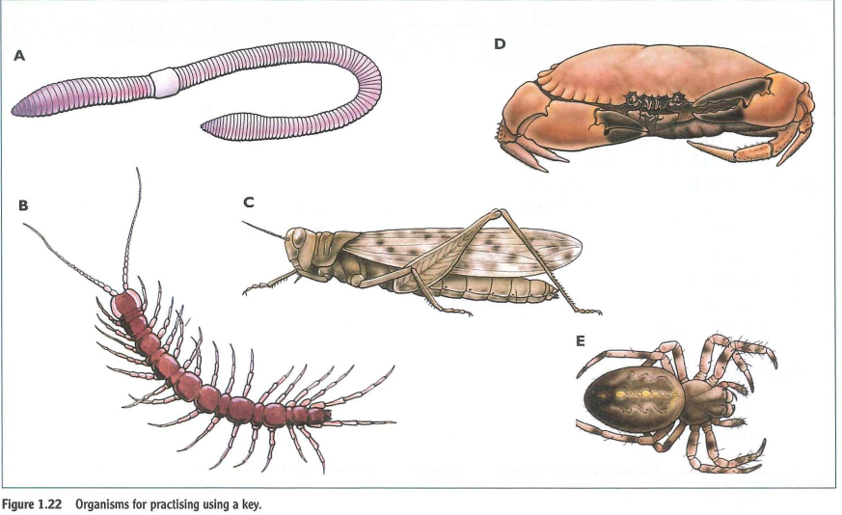
Dichotomous key
Q: Using this key, how do you find out what is organism A, D, E?

Slide 3
What is a good dichotomous key like?
Tips
pairs of characters that can be distinguished clearly, while looking only at one leaf (so, for example, pairing ‘large’ and ‘small’ is not suitable)
pairs of characters that are related to one another (e.g. so, for example, pairing ‘serrated margin’ and ‘network of veins’ is not suitable)
a key that works in as few pairs of points as possible. Usually (n-1) pairs of statements is enough to distinguish n organisms.
Task
Build a dichotomous key to distinguish the four flowers on P16.
Step 1. Make a list of 2 or more feature you can use to distinguish the flowers.
Step 2. Construct a key using the features you listed in step 1).
Q: Can I use number of petals as a feature to distinguish the flowers?
Q: Can I use the size of flowers?

Slide 4
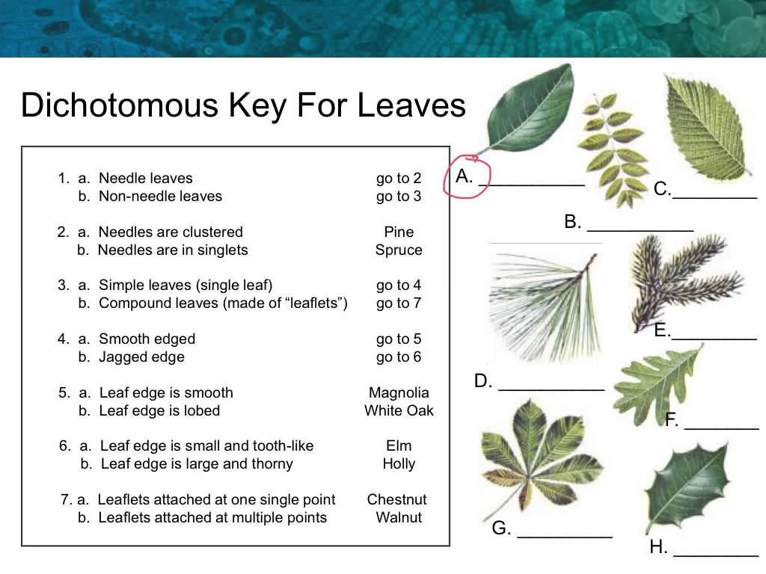

Slide 5
Scientific drawing
Outline
Use a sharp HB pencil.
Draw with free hand, do not use a ruler or a compass.
Draw continuous, single line (not many tries at the same line.), without gaps, tails or overlaps.
Do not shade in anything. Do not use colour.
Size
Make a large drawing, within the space provided, at least bigger than the original photograph.
Detail
Draw as accurately as you can, with different parts in the correct proportions.
Count things – if there’s three, draw three.
Label
Only write labels when you are asked in the question.
Label clearly using a single line to touch the structure being labelled.
Write labels horizontally and neatly, well away from the diagram itself, not on or in the diagram.

Slide 6
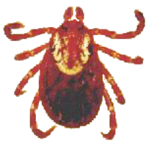
Example 1
A
B
C
Q: Which one drawing is the one we prefer in exam? What‘s wrong with the other two drawings?

Slide 7
Example 2
Mark scheme
Examiner’s feedback

Slide 8
Drawing task
You are provided with several specimens. Pick one and draw.

